Slide 1
Parameters (base model) AIC = 547.12 -LogLik = 273.56
Abbrev | Symbol | Full parameter name (fix or potentially estimate*) | Initial (or fitted) value
delM | δ_{M} | Shape corrector (fix) | 0.1066
dV | d_{V} | Dry weight density (fix) | 0.4
sJAm | Jª_{Am} | Area-specific assimilation rate | 0.333
sJM | J^{v}_{M} | Volume-specific maintenance costs | 0.0214
WB0 | W_{B0} | Initial egg weight (fix) | 0.15
Lwp | L^{M}_{p} | Total length at puberty (fix) | 100
yAV | y_{AV} | Yield of assimilates on volume, starvation (fix) | 0.8
yBA | y_{BA} | Yield of egg buffer on assimilates, reproduction (fix) | 0.95
yVA | y_{VA} | Yield of structure on assimilates, growth | 0.3646
kappa | κ | Allocation fraction to soma (fix) | 0.8
f | f | Scaled food level (fix) | 1
fB | f_{B} | Scaled food level, embryo (fix) | 1
Lwf | L_{f}? | Half-saturation total length (fix) | 0
mu_emb | h_{emb} | Mortality rate for embryos | 0.06393
mu_lar | h_{lar} | Mortality rate for larvae | 0.02940
Notes:
Can’t estimate kappa without reproduction data.

Slide 2
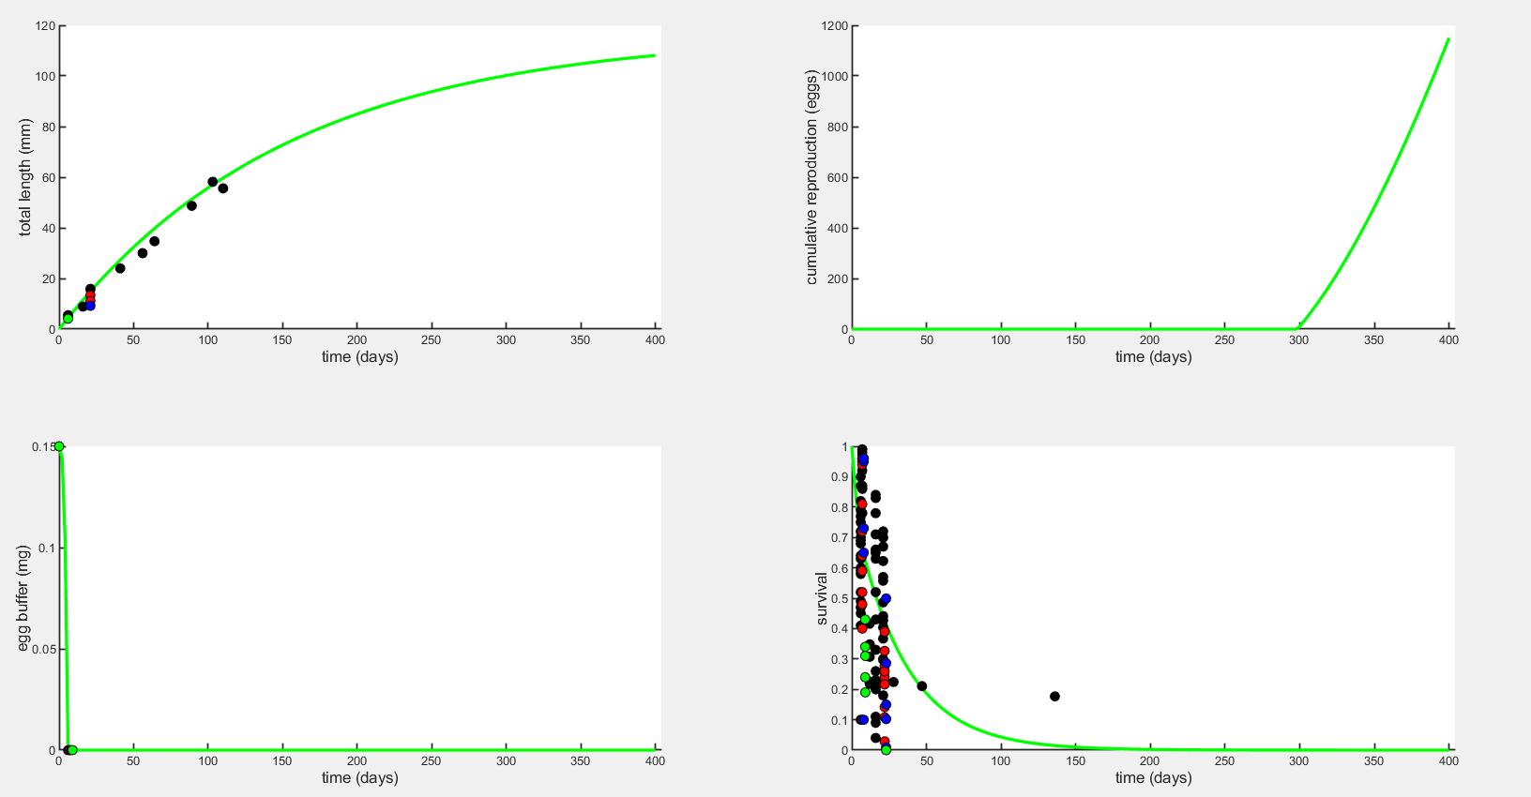
Plot to 400 days
Without hypoxia effect, the green line is control DO

Slide 3
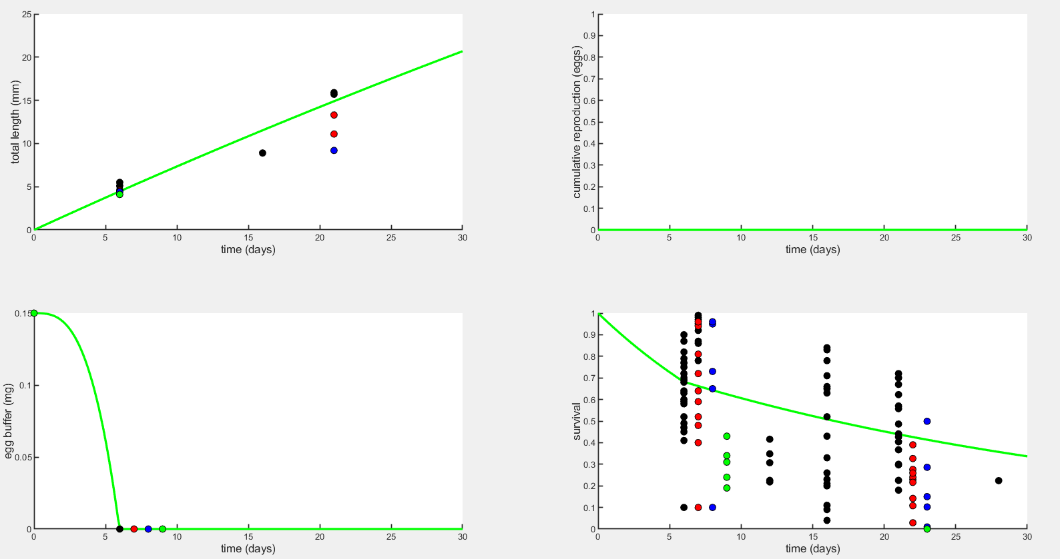
Plot to 30 days
Without hypoxia effect, the green line is control DO

Slide 4
Stress function for Maintenance and Mortality
Objective
Make a table of what happens to each type of data at a few different values of each parameter, and maybe a figure of the predicted data (without observed?) where each color is a different value of the parameter.
Run the simulation with fitting turned off and a few different values of the parameter of interest.
Can’t set weights of all but one data type to zero and get NLL or AIC – unless at least two data points are not set to zero, the NLL = Inf.

Slide 5
Applying stress function to each parameter of interest
Parameter(s) affected by stress | Direction of effect | Best K | AIC | Best J | AIC | Notes
sJAm | ↓ | 2e-16 | 622.80 | 1.688 | 616.82 | Best fit version with K has no hypoxia effect. The value of DO_{c} affects the best estimate of J, with a lower DO_{c} leading to a lower J. There is also a local minimum around 0.5 but global minimum around 1.5.
yVA | ↓ | 2e-16 | 622.80 | 1.480 | 620.43 | Very similar to sJAm.
sJM | ↑ | 0.8119 | 615.64 | 0.3634 | 614.02 | Changing DO_{c} doesn’t affect the estimates very much, unlike sJAm and yVA. Length is the only thing affected. This successfully allows maintenance to change more.
mu_emb | ↑ | 0.9487 | 604.13 | 0.6334 | 602.55 | Only affects survival (of course), not length or egg buffer.
mu_lar | ↑ | 2.044 | 596.98 | 0.3275 | 593.66 | Post-hatch survival is able to get very close to the observed.
sJAm & sJM | ↓ & ↑ | 2e-16 | 622.80 | 0.5847 | 677.00 | Best fit gives too great of hypoxia effect.
yVA & sJM | ↓ & ↑ | 2e-16 | 622.81 | 1.511 | 618.38 | There is sometimes a local minimum around J=0.5 and a global minimum around J=1.5, detected by plotting loglik.
May need to set an upper bound where c=1 so that control has no hypoxia effect.
When working with sJAm and yVA the best fit doesn’t look that good to me.

Slide 6
Applying stress function to each parameter of interest
Parameter(s) affected by stress | Direction of effect | Best K | AIC | Best J | AIC | Notes
sJAm & mu_emb | ↑ & ↓ | 0 | 622.81 | 1.688 | 607.13 | A little weak of a hypoxia effect. When using K there was a local minimum that gave more reasonable results (K=0.28).
yVA & mu_emb | ↑ & ↓ | 2e-16 | 622.81 | 1.331 | 606.59 | Ditto. But the version using J gives pretty reasonable hypoxia effects.
mu_emb & mu_lar | ↑ & ↑ | 0.7062 | 599.53 | 0.7717 | 597.30
sJM & mu_emb | ↑ & ↑ | 0.8633 | 598.23 | 0.5069 | 599.58
sJAm & mu_lar | ↓ & ↑ | 2e-16 | 622.81 | 1.688 | 611.90 | When using J there was a local minimum at J=0.55.
yVA & mu_lar | ↓ & ↑ | 2e-16 | 622.81 | 1.371 | 611.49 | Ditto
sJM & mu_lar | ↑ & ↑ | 1.038 | 595.45 | 0.3582 | 585.76
sJAm & mu_lar & mu_emb | ↓&↑&↑ | 0 | 622.81 | 1.688 | 603.84
sJM & mu_lar & mu_emb | ↑&↑&↑ | 0.7430 | 592.68 | 0.7117 | 596.12
sJAm & sJM & mu_emb & mu_lar | ↓&↑&↑&↑ | 0 | 622.81 | 1.709 | 603.94

Slide 7
Plot legend
Black = 8 mg/L (control)
Red = 4 mg/L
Blue = 3 mg/L
Green = 2.5 mg/L

Slide 8
Mean data values for each DO treatment
This could be useful when viewing the plots and how well the predicted values fit (because for survival and length there are multiple data points on the plot).
 | 7.7 mg l⁻¹ | 4.2 mg l⁻¹ | 3.1 mg l⁻¹ | 2.7 mg l⁻¹
Survival to hatching | 74.3% (range 41-100%) | 70.6% (range 40-100%) | 85.8% (range 65-100%) | 30.2% (range 19-43%)
Hatch time (egg buffer=0) | 6 days | 7 days | 8 days | 9 days
Length at hatching | 5.3 mm | 4.55 mm | 4.4 mm | 4.1 mm
Larval length at 15 dph* | 15.8 mm | 12.2 mm | 9.2 mm | NA
Larval survival to 15 dph* | 44.0% (range 4-84%) | 22.2% (range 3-33%) | 20.9% (range 1-50%) | 0% (range 0-0%)
*15 days post hatching = 21-24 days post fertilization, because low oxygen delays hatching

Slide 9
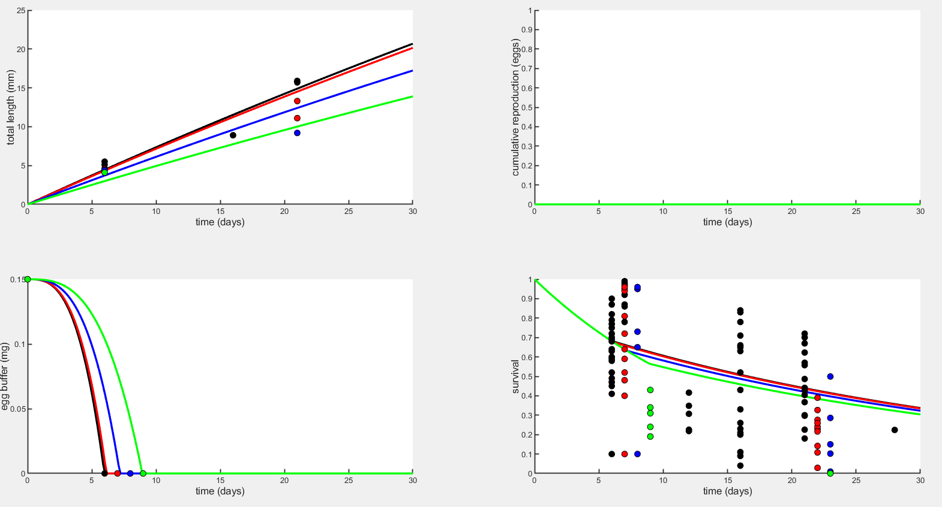
Early life plots – Assimilation (sJAm) with Option 2 (J=1.688)

